Slide 1
Boosting
UIUC ECON 490: Applied Machine Learning in Economics

Slide 2
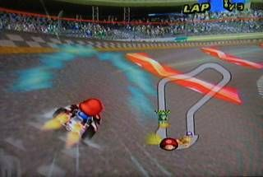
Boosting

Slide 3
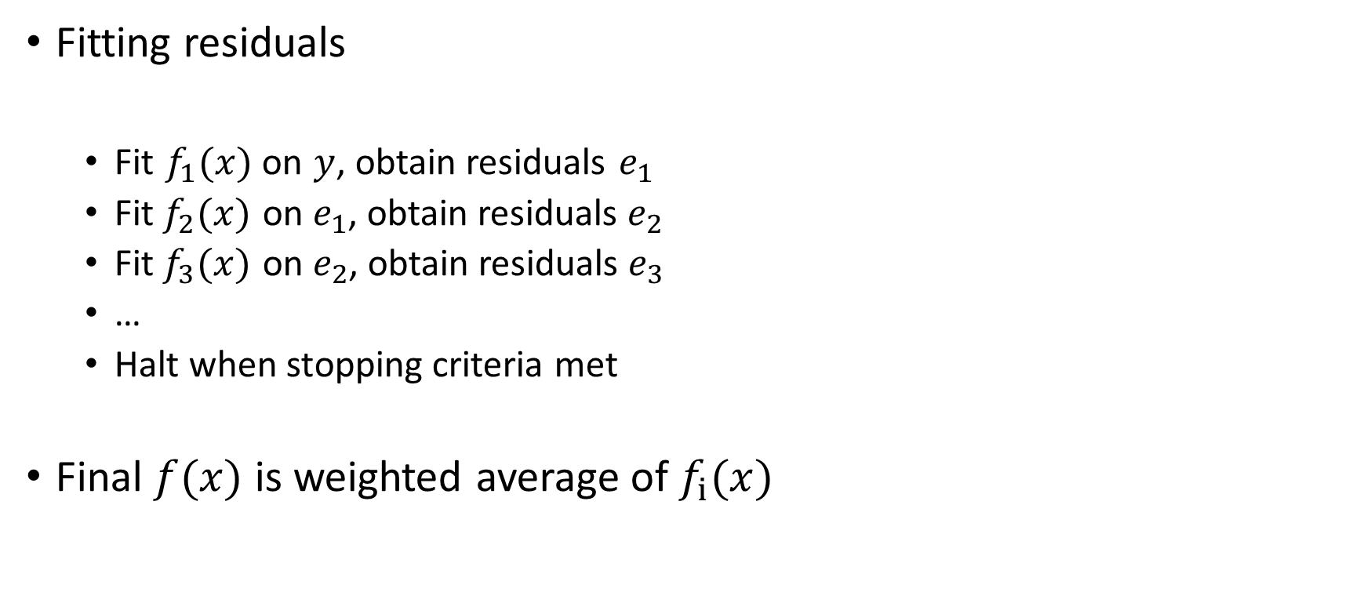
Boosting
Fitting residuals
Fit $f_{1}(x)$ on $y$, obtain residuals $e_{1}$
Fit $f_{2}(x)$ on $e_{1}$, obtain residuals $e_{2}$
Fit $f_{3}(x)$ on $e_{2}$, obtain residuals $e_{3}$
…
Halt when stopping criteria met
Final $f_{ }(x)$ is weighted average of $f_{i}(x)$

Slide 4
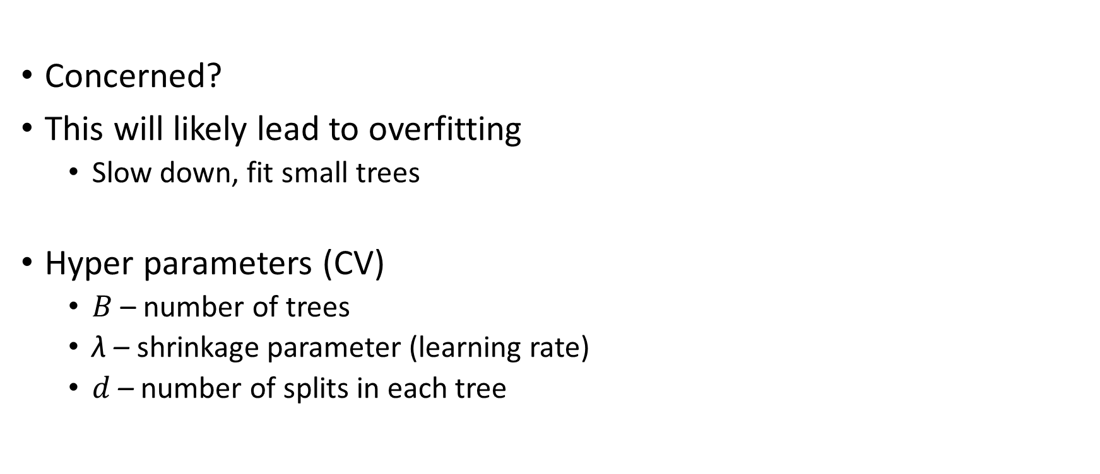
Boosting
Concerned?
This will likely lead to overfitting
Slow down, fit small trees
Hyper parameters (CV)
$B$ – number of trees
λ – shrinkage parameter (learning rate)
$d$ – number of splits in each tree

Slide 5
In Practice
Normally use tree-based models
Relatively high variance, relatively low bias
Can fit any class of model at any stage
Stage 1: OLS
Stage 2: KNN
Etc.

Slide 6
Different Boosting Methods
Gradient Boosting (regular)
Minimize familiar loss functions
MSE & Error Rate
Adaptive Boosting (adaboost)
Fit stumps (one split tree) i.e. “weak learners”
Weight misclassified models more
Fit another stump, rinse and repeat.
Particularly inefficient with noisy data
Extreme Gradient Boosting (xgboost)
Minimize 2nd derivative of familiar loss functions
Provides direction of minimization (Newton’s method)
MUCH faster and accurate!

Slide 7
To do
Watch
Ensemble learning by Udacity on YouTube
Complete
Lab 8.3

